Slide 1
SOFTWARE TESTING
Harrod’s Inventory Management
Sub Topic : Web Service Testing with emphasis on Security
Karan Desai & Mandanna Thekkada
Department of Computer Science,
Rutgers University

Slide 2
Overview
Application Details
Implementation Details
Software Requirement Specification
Testing Overview
Unit Testing
Control Flow Testing
Web service Details
Web service Security Testing
Burp Suite, SoapUI introduction
Mutation Testing

Slide 3
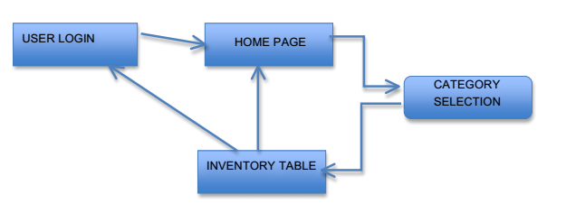
Application Details
Simple Inventory Management for Harrod’s
To track the current number of available items
Books, Appliances, Clothes
Users : Store Managers, Warehouse Staff, Inventory Admin

Slide 4
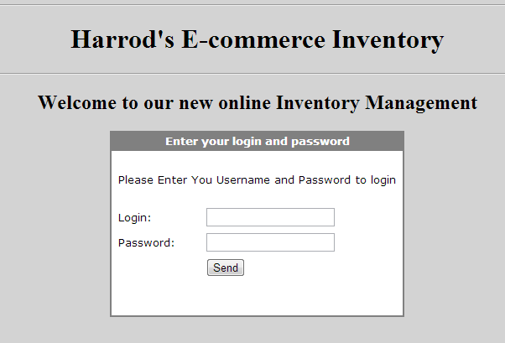
Application Details : Login

Slide 5
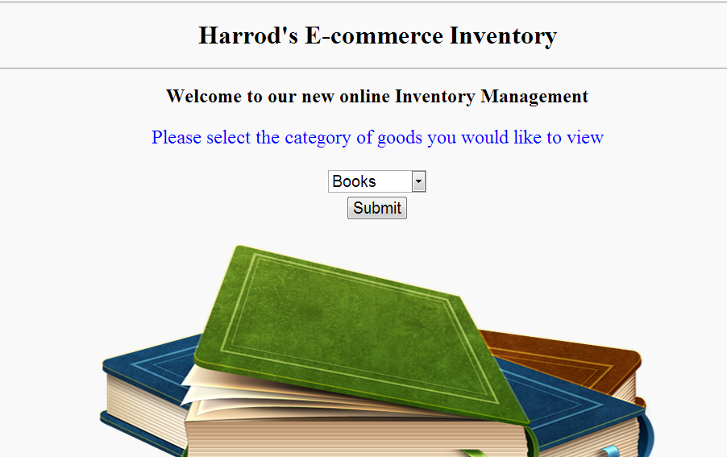
Application Details : Category Selection

Slide 6
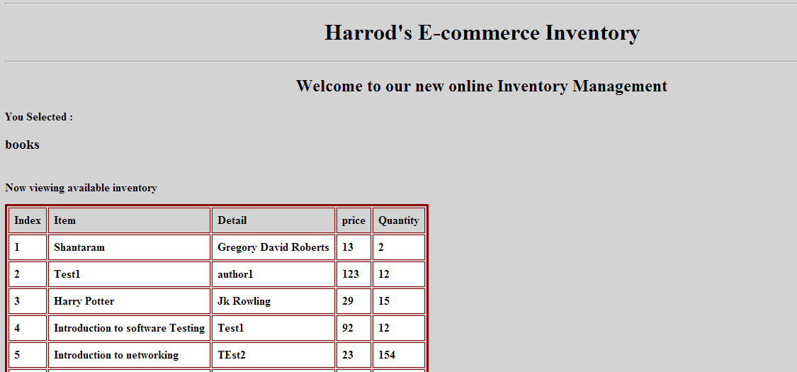
Application Details : Inventory

Slide 7
Implementation Details
Front End
HTML5 ( + JavaScript + CSS3.0 )
BackEnd
XAMPP
PHP5.0
MySQL
SOAP Protocol using NuSOAP
Web service WSDL

Slide 8
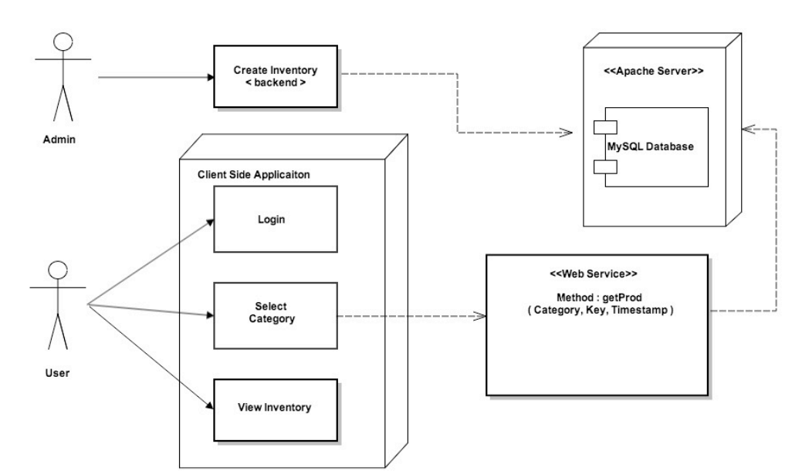
System Architecture

Slide 9
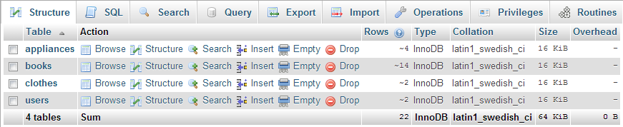
Database

Slide 10
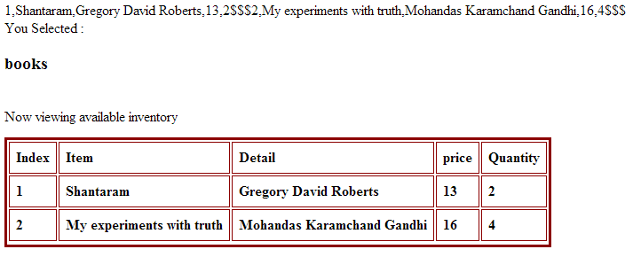
Unit Testing for client
UNIT TESTING FOR DATA PROCESSING OF STRING VALUES RECEIVED FROM THE WEB SERVICE

Slide 11
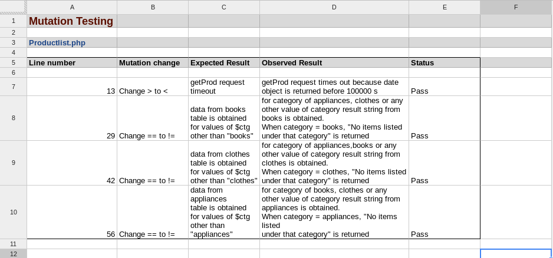
Mutation Testing

Slide 12
Control Flow Testing
https://docs.google.com/document/d/1vArOmjxp0b85wcCtRQRofBpgs4zikTkdJsd3QCPq4uE/edit?usp=sharing
https://docs.google.com/document/d/13daZVOhbs4Hjn9wXlseiZp86MMyUXiKmXnMKk-pTTz0/edit?usp=sharing
(Will open in google drive separately for DEMO)

Slide 13
GUI Testing of Web Elements
EXAMPLES
Submit/Button
The button should be clickable
Being able to trigger action
Click each button once with the mouse - This should activate
Tab to each button - Press RETURN - This should activate
Tab to each button - Press SPACE - This should activate
Drop Down Menu
Pressing the Arrow should give list of options
This List may be scrollable
You should NOT be able to type text in the box
Pressing a letter should bring you to the item

Slide 14
Web Service
Method : Get Prod (Category, Key, Timestamp)
Description : Retrieve information from the database about a specific category
Synopsis: POST {URI}
Request Headers: SOAP
Request Message Body: SOAP requests/ XML method data / Category / Key/ Time-Stamp
Response Headers: Content-Length, Content-Type.
Response Message Body: Database query result
Response Status: 200

Slide 15
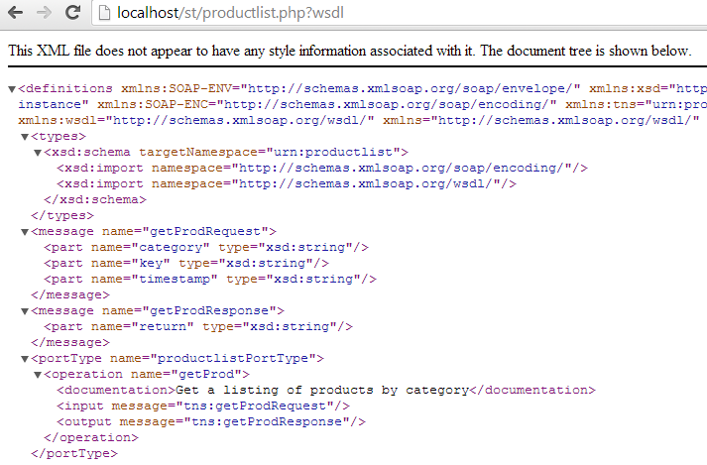
WSDL ( Web Service Definition Language )

Slide 16
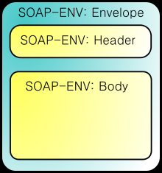
SOAP
Simple Object Access Protocol
protocol specification for exchanging structured information in the implementation of Web Services
It relies on XML Information Set for its message format, and usually relies on other Application Layer protocols, most notably Hypertext Transfer Protocol (HTTP) or Simple Mail Transfer Protocol (SMTP) for message negotiation and transmission
Our implementation uses NuSOAP Library made
for Php

Slide 17
Sample Request
POST /st/productlist.php HTTP/1.0 Host: localhost User-Agent: NuSOAP/0.9.5 (1.123) Content-Type: text/xml; charset=ISO-8859-1 SOAPAction: "urn:productlist#getProd" Content-Length: 656 <?xml version="1.0" encoding="ISO-8859-1"?><SOAP-ENV:Envelope SOAP-ENV:encodingStyle="http://schemas.xmlsoap.org/soap/encoding/" xmlns:SOAP-ENV="http://schemas.xmlsoap.org/soap/envelope/" xmlns:xsd="http://www.w3.org/2001/XMLSchema" xmlns:xsi="http://www.w3.org/2001/XMLSchema-instance" xmlns:SOAP-ENC="http://schemas.xmlsoap.org/soap/encoding/" xmlns:tns="urn:productlist"><SOAP-ENV:Body><tns:getProd xmlns:tns="urn:productlist">
<category xsi:type="xsd:string">books</category>
<key xsi:type="xsd:string">hji534r83hsdnf2avgvd2ev231fe</key>
<timestamp xsi:type="xsd:string">12/16/2013 08:06:26 pm</timestamp>
</tns:getProd></SOAP-ENV:Body>
</SOAP-ENV:Envelope>

Slide 18
Sample Request
HTTP/1.1 200 OK Date: Mon, 16 Dec 2013 19:06:26 GMT Server: Apache/2.4.4 (Win32) OpenSSL/0.9.8y PHP/5.4.19 X-Powered-By: PHP/5.4.19 X-SOAP-Server: NuSOAP/0.9.5 (1.123) Content-Length: 968 Connection: close Content-Type: text/xml; charset=ISO-8859-1 <?xml version="1.0" encoding="ISO-8859-1s"?><SOAP-ENV:Envelope SOAP-ENV:encodingStyle="http://schemas.xmlsoap.org/soap/encoding/" xmlns:SOAP-ENV="http://schemas.xmlsoap.org/soap/envelope/" xmlns:xsd="http://www.w3.org/2001/XMLSchema" xmlns:xsi="http://www.w3.org/2001/XMLSchema-instance" xmlns:SOAP-ENC="http://schemas.xmlsoap.org/soap/encoding/"><SOAP-ENV:Body><ns1:getProdResponse xmlns:ns1="urn:productlist">
<return xsi:type="xsd:string">1,Shantaram,Gregory David Roberts,13,2$$$2,Test1,author1,123,12$$$3,Harry Potter,Jk Rowling,29,15$$$4,Introduction to software Testing,Test1,92,12$$$5,Introduction to networking,TEst2,23,154$$$</return>
</ns1:getProdResponse>
</SOAP-ENV:Body></SOAP-ENV:Envelope>

Slide 19
Web Service Security
Very different than simply “web applications with a backend”
Standalone entity
Reusable code
Will reply to any client
Multiple applications , different languages and different platforms can communicate to it and get responses
Testing the web application does not test the web service
Raw requests have to be changed using some tools
Our application - key, timestamp
Other enhancements - XML encryption ( not recommended )
WS- Security: Username/ Password

Slide 20
WS Security
WS-Security (Web Services Security, short WSS) is an extension to SOAP to apply security to web services. It is a member of the WS-* family of web service specifications.
The protocol specifies how integrity and confidentiality can be enforced on messages and allows the communication of various security token formats, such as SAML, Kerberos,etc
User Cases
End to End Security
Non Repudiation
Security Token
Our Suggestion for easy implementation
Key or Username/password in header ( Server-Client Authentication)
Time Stamp ( Protect Against general Replay attacks)
Encryption ( can be implemented with the key already present, affects performance)

Slide 21
SoapUI and Burp Suite Combination
User SoapUI to get Web Service Methods from the WSDL file
User Burp Suite to catch Requests, Repeat and Intruder to Fuzz
Can also be used to do Brute Force on Login
DEMO TIME

